Slide 1
Rice Image Classification Using CNNs
Justin Reji George

Slide 2
Agenda
Introduction
Dataset
Rice Varieties
Image Preprocessing
Network Architecture
Results
Conclusion
Questions

Slide 3
Introduction
Background Rice is one of the most widely produced and consumed grain crops globally, with numerous genetic varieties grown in different regions. These varieties are distinguishable by physical characteristics such as texture, shape, and color, which play an important role in quality control and classification in the Agriculture Industry.
Goal Use convolutional neural networks (CNNs), to classify these rice varieties to its respective classes with high accuracy.

Slide 4
Dataset
The dataset consists of 60,000 rice images, 15,000 for each variety.
The dataset contains 4 classes of rice:
Arborio
Basmati
Ipsala
Jasmine
Resolution: Original image sizes 250×250 pixels

Slide 5
Rice Varieties
Arborio: Short, fat, oval-shaped grain, known for its creamy texture and commonly used in risotto. Grown mostly in Italy but used in international dishes as well.
Basmati: Long, slender grain with aromatic fragrance, used widely in Indian, Pakistani, and Middle Eastern cuisine. Grown primarily in the Himalayan foothills and is low in starch compared to other varieties.
Ipsala: Grown in the Ipsala region of Turkey, it’s a medium-long grain, and has a slightly sticky texture when cooked. Popular in Turkish pilaf dishes.
Jasmine: Long grain rice from Thailand, its soft and slightly sticky when cooked and is popular in Southeast Asian cuisine. It has a similar fragrance to Basmati but has a softer texture when cooked.

Slide 6
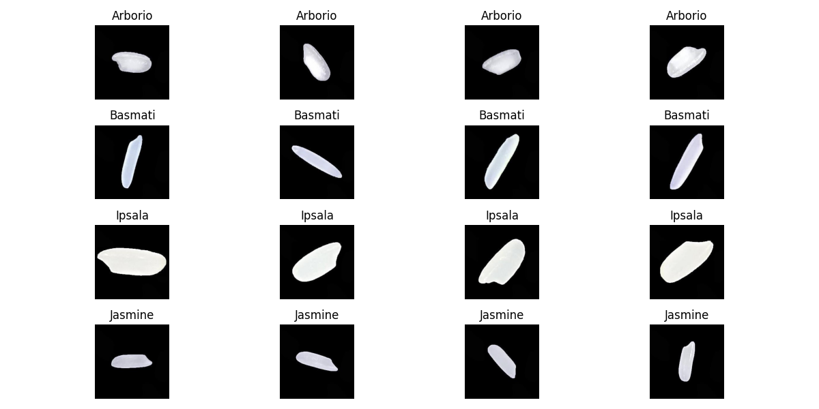
Overcoming nervousness

Slide 7
Image Preprocessing
Resizing: All images scaled down to 64×64 pixels using transforms.Resize()
Normalization: RGB values normalized using transforms.Normalize() using the calculated mean and standard deviation
Data split:
70% training
15% testing
15% validation

Slide 8
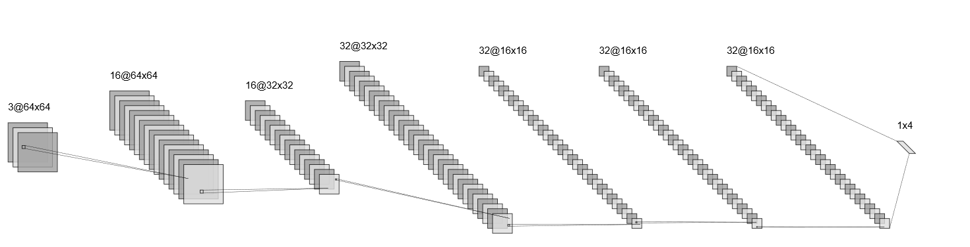
Network Architecture
FC Output Layer
# 4 Classes
Convolution + ReLU
Max-Pool
Convolution + ReLU
Max-Pool
Flatten
32 * 16 * 16 = 8192
FC Layer + ReLU

Slide 9
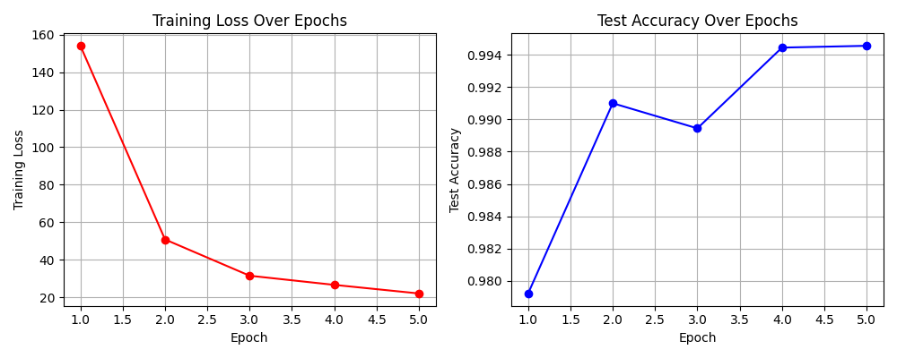
Results
Total parameters: 268164
Training loss and test accuracy plotted over 5 epochs
Validation Accuracy: 0.9956

Slide 10
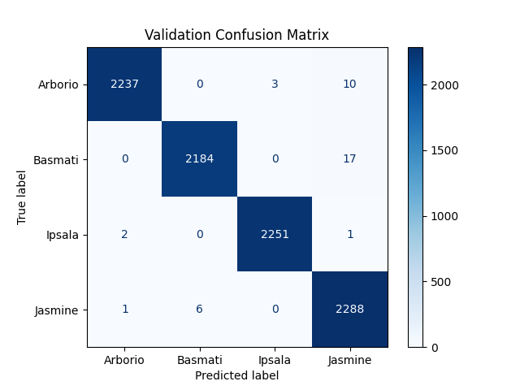
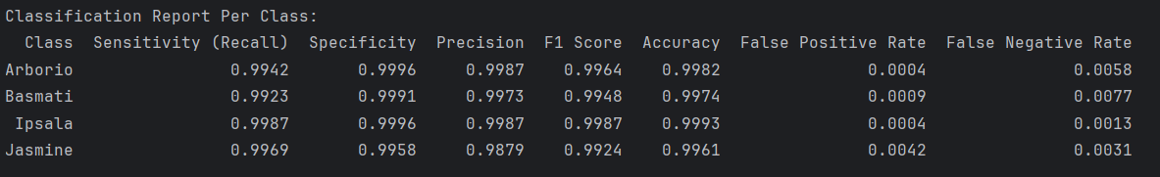
Results

Slide 11
Conclusion
Achieved high accuracy with a CNN
The model effectively distinguishes between different rice types
Used Cross-Entropy as loss function

Slide 12
Questions?

